Slide 1
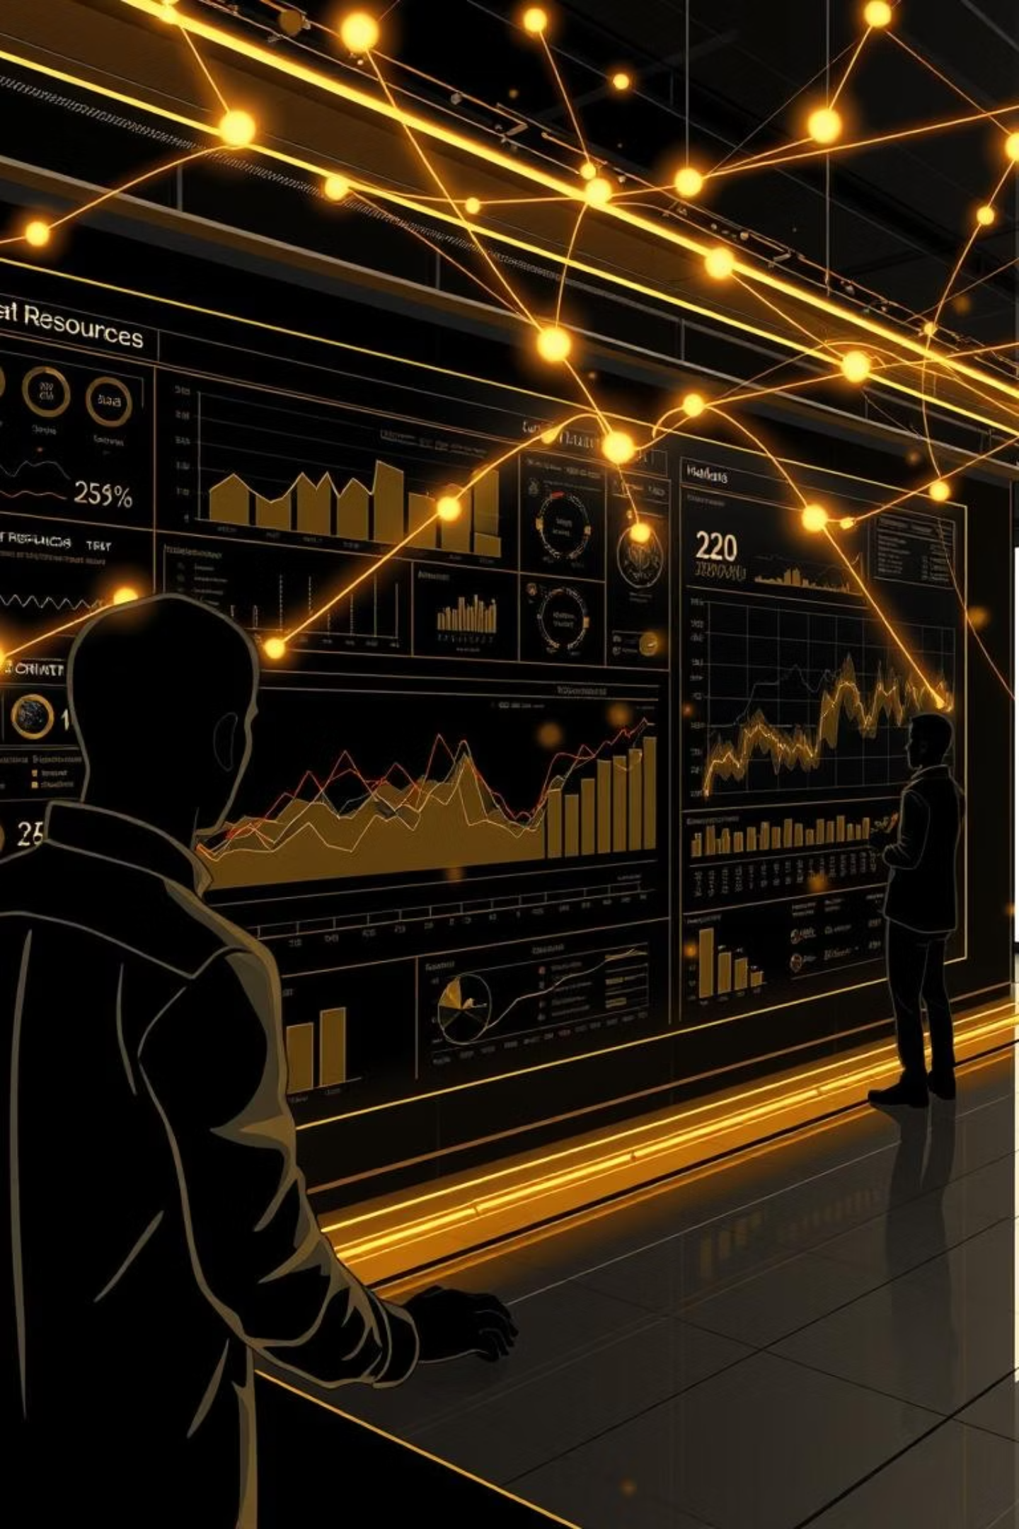
AI-Powered HR Insights:Unifying Your Workforce Data
-Presented by:
Team SLYTHERIN
Discover the future of Human Resources with our Unified HR Insights Dashboard, designed to transform raw data into strategic intelligence. This platform empowers HR and People Ops leaders to make informed decisions, optimize talent management, and foster a thriving workplace.

Slide 2

The Challenge: Fragmented Data, Missed Opportunities
In today's fast-paced environment, HR teams often grapple with disparate data sources, making it difficult to gain a holistic view of their workforce. This fragmentation leads to reactive strategies, overlooked trends, and missed opportunities for proactive talent management.
Siloed HR systems
Manual data compilation
Lack of real-time insights
Difficulty in identifying trends

Slide 3

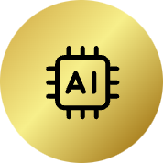




Our Solution: A Unified AI-Powered HR Dashboard
Our innovative dashboard centralizes critical HR data, from attendance to performance reports, providing a single source of truth. With AI and machine learning at its core, it delivers actionable insights that drive strategic HR initiatives.
Centralized Data
AI-Powered Insights
Actionable Intelligence
Integrate all HR data streams into one intuitive platform.
Leverage machine learning for predictive analytics and recommendations.
Convert data into clear, strategic steps for HR leaders.

Slide 4

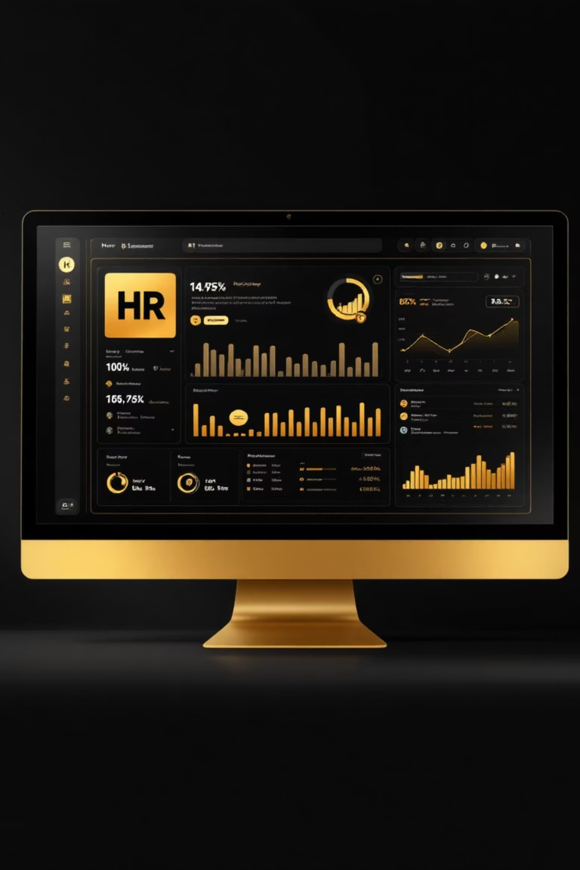
Empowering New Hires: A Seamless Start
For new employees, our dashboard provides a dedicated view to ensure a smooth and engaging onboarding experience. From the moment they accept an offer, we keep them connected and informed.
->Joining Tracker with Countdown: Engage new hires with a personalized countdown to their start date, building anticipation.
->Location-Wise Insights: Access pivot tables and exportable Excel sheets for granular details on employee distribution.
->Comprehensive Onboarding View: Easily track role, joining date, and location for all new team members.

Slide 5
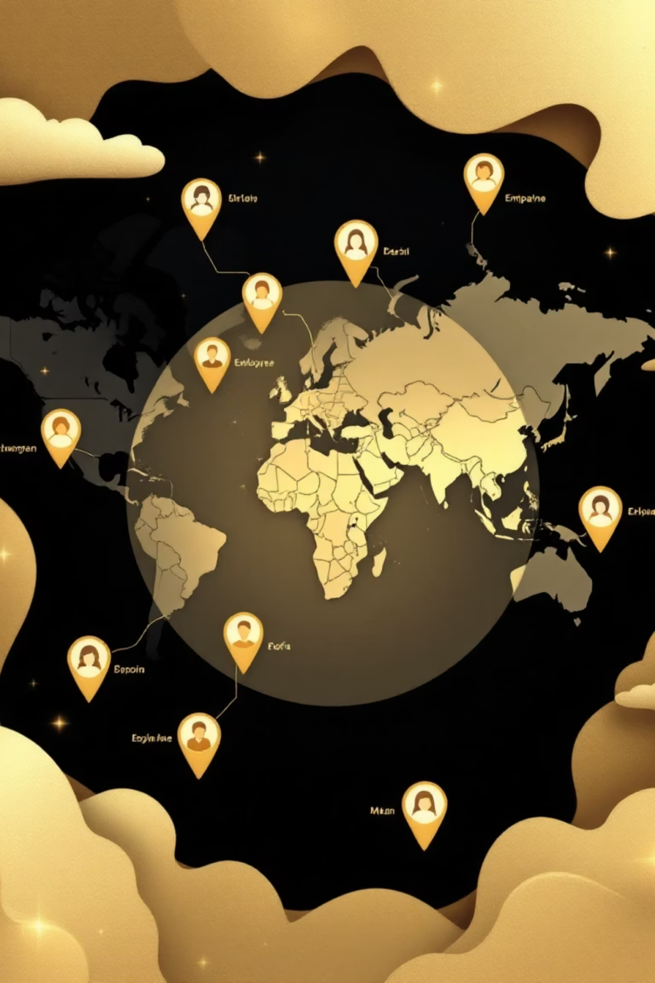


Location Intelligence at Your Fingertips
Pivot Table Analysis
Dynamic location-wise employee insights with drag-and-drop pivot functionality for instant data exploration.
Export Ready Reports
One-click Excel sheet generation for detailed location analytics, perfect for executive reporting and compliance.

Slide 6

Enhancing the Existing Workforce: Performance & Engagement
Beyond new hires, the dashboard provides a deep dive into the performance and engagement of your current
employees, identifying strengths and areas for development.
Performance Analysis
Track productivity, engagement levels, and individual
profit contribution.
KPI Visualizations & Alerts
Monitor Key Performance Indicators with clear visualizations and proactive alerts for critical changes.

Slide 7
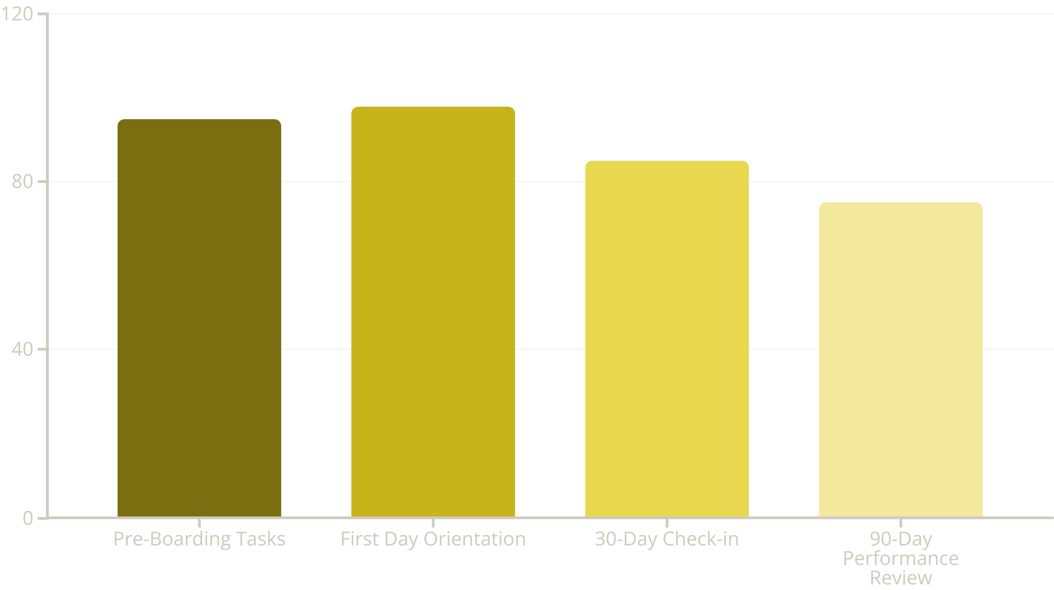
Optimizing Onboarding: Key Metrics
Visualize the onboarding process to identify bottlenecks and areas for improvement, ensuring every new hire is set up for success.
These completion rates provide valuable insights into our onboarding program's effectiveness at various stages. We aim for continuous improvement.

Slide 8



AI-Driven Insights for Talent Management
Unleash the power of AI to gain unparalleled foresight into your talent landscape. Our system predicts future trends and provides strategic recommendations.
Identify Top Performers
Detect Burnout Risks
Recommend Promotions
Pinpoint high-achievers and rising stars within your organization.
Proactively identify employees at risk of burnout and intervene effectively.
Utilize data-backed suggestions for internal promotions and career growth.

Slide 9
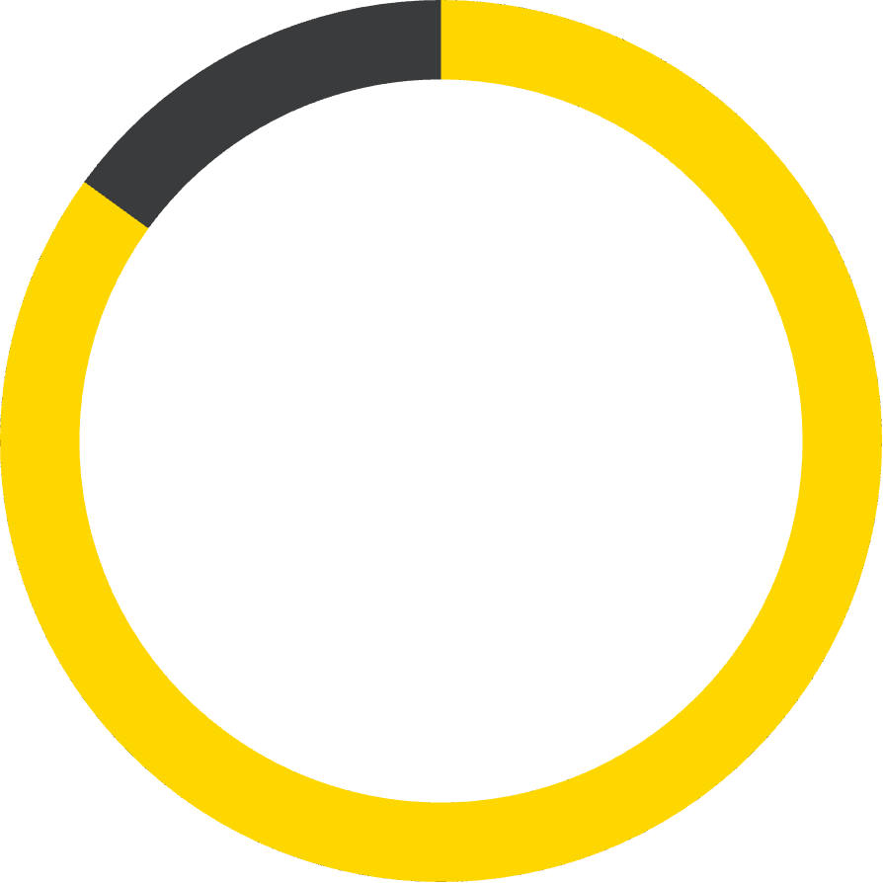
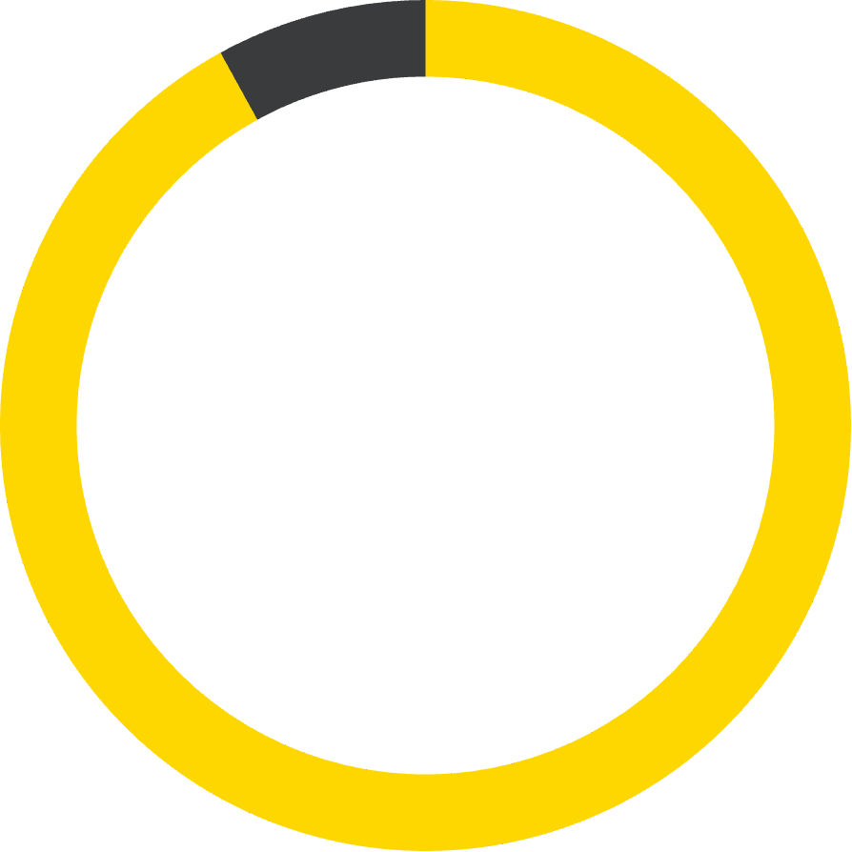
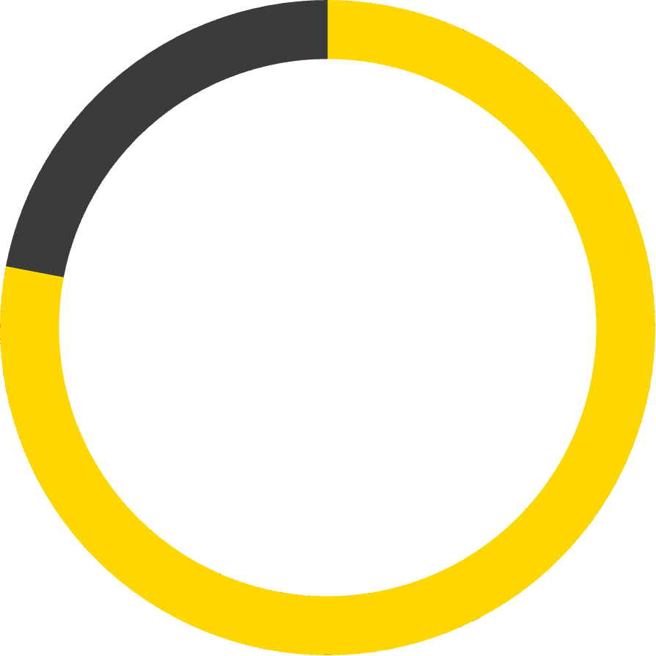
Performance Intelligence for Existing Teams
85%
92%
78%
Productivity Tracking
Engagement Scores
Profit Contribution
Real-time productivity metrics with goal alignment and progress visualization.
Continuous pulse surveys and sentiment analysis to measure team engagement levels.
Revenue attribution models linking individual performance to business outcomes.

Slide 10
The Technology Underpinnings
Built on robust and scalable technology, our HR Insights Dashboard ensures data security, flexibility, and ease of use.
Responsive UI
Excel/CSV Imports
Access insights anytime, anywhere, on any device.
Seamlessly integrate existing data from various sources..
AI/ML Analytics
Automated Reporting
Advanced algorithms for deep, predictive insights.
Generate regular reports effortlessly, saving time and resources.

Slide 11

Transform Your HR Strategy Today
1
Reduce time-to-hire by 40%
Streamlined onboarding workflows and predictive analytics accelerate talent acquisition processes.
2
Increase retention by 25%
Early warning systems and personalized interventions keep top talent engaged and productive.
3
Drive data-driven decisions
Replace gut instincts with actionable insights that align workforce strategy with business objectives.

Slide 12

Impact on Your Organization
Implementing the Unified HR Insights Dashboard leads to tangible benefits across your organization, fostering a more engaged, productive, and satisfied workforce.
Increased Employee Retention: By understanding and addressing key factors.
Improved Talent Acquisition: Streamlined processes attract top talent.
Enhanced Decision Making: Data-driven strategies for HR initiatives.
Optimized Resource Allocation: Deploy talent where it matters most.

Slide 13


